Slide 1
LUXESTAY (Luxury Staying)
Hotel Booking Website
(Cutomer Values)

Slide 2
Today’s Agenda
Introduction
Design Overview
Tools & Technologies
Frontend Development
Backend Development
Challenges and Pitfalls
Achievements
Conclusion

Slide 3

Introduction and Key benefits:
User Interface (UI)
Database Management System (DBMS)
Backend Logic:
Room Listings and Descriptions
Admin Dashboard

Slide 4
INTRODUCTION
The motel booking internet site assignment goals to leverage contemporary internet technologies to offer users with a unbroken and handy platform for surfing, deciding on, and booking inn rooms.
Online booking platforms have revolutionized the manner human beings plan and book their motels, presenting comfort, preference, transparency, and protection.
The assignment utilizes a aggregate of HTML, CSS, JavaScript, PHP, and MySQL to create a dynamic and interactive internet site catering to users and administrators.

Slide 5
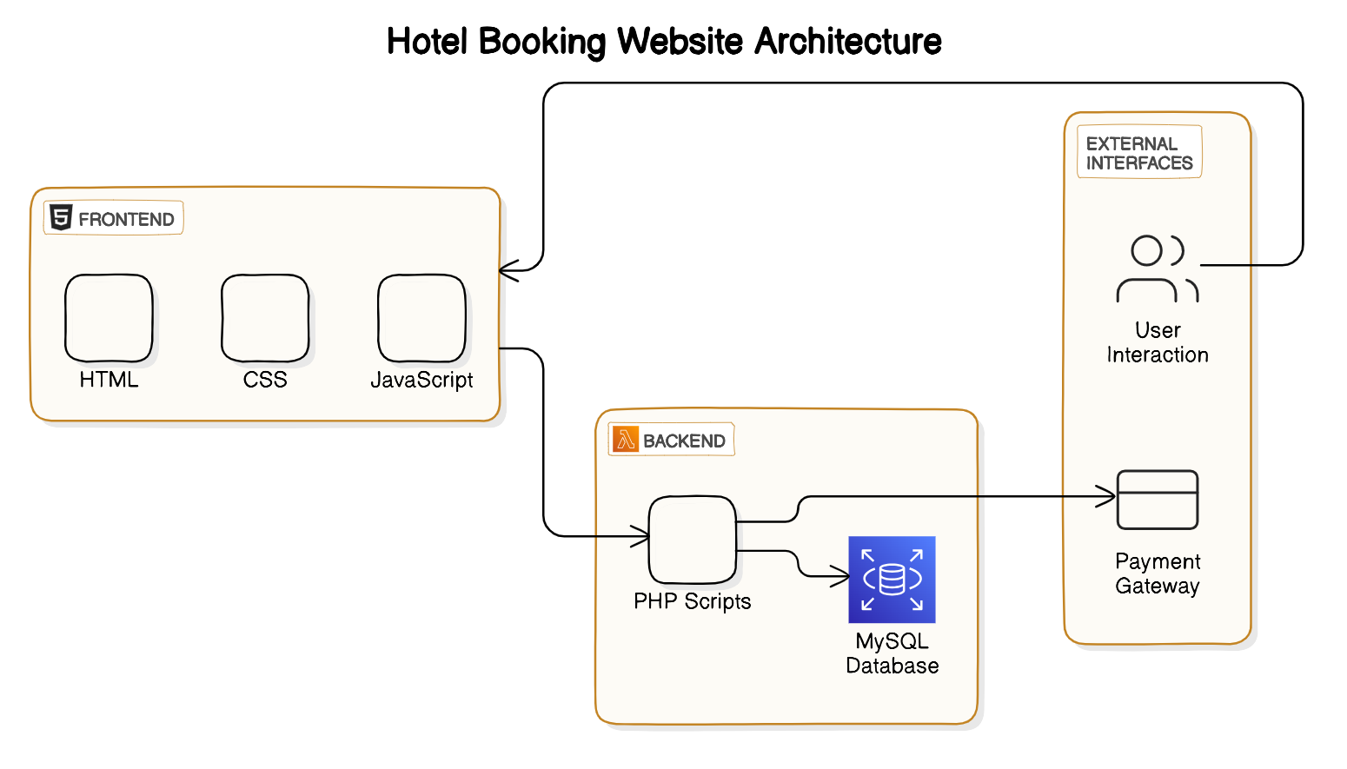
DESIGN OVERVIEW

Slide 6
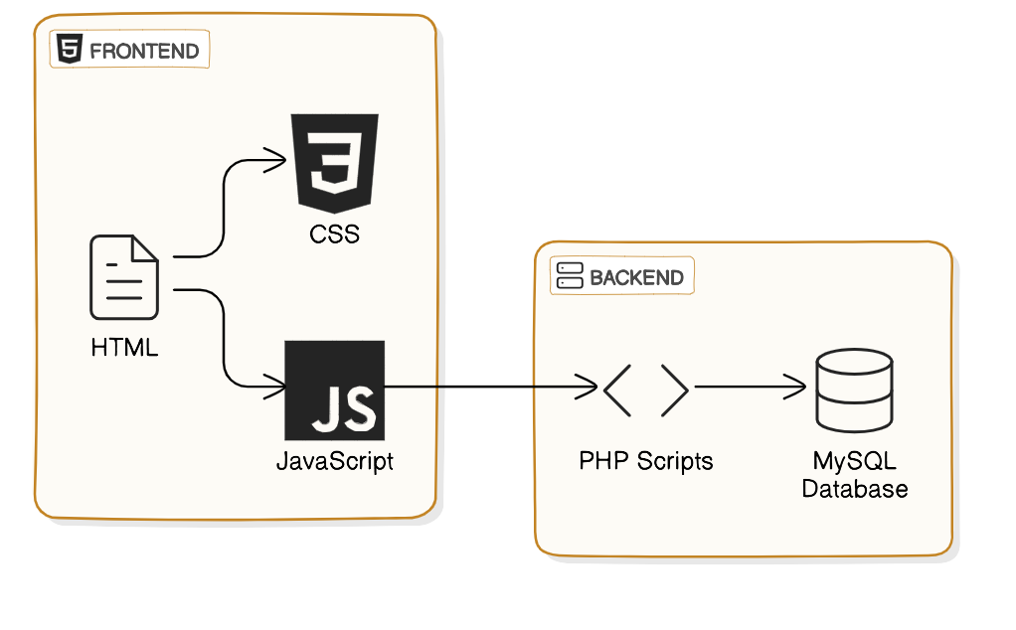
TOOLS & TECHNOLOGIES:
Frontend additives consist of HTML, CSS, and JavaScript, responsible for the structural layout, visible presentation.
Backend components incorporate PHP scripts and a MySQL database, managing server-side processing, information manipulation, and database operations.

Slide 7



Frontend Development:
HTML Structure: Once the basic designing was done then we focused on developing the structure of the website with the help of HTML elements.
CSS Styling: After creating the structure of the website using HTML, we used the CSS to style the elements and components. So that the overall user experience improves.
Javascript Interactivity: We used Javascript to add the interaction to our website such as animation, validation etc.

Slide 8


Backend Development:
Database Integration: Interact with the database developed using MySQL to perform the CRUD operations (i.e Create, Read, Update, Delete)
Server-side Scripting: Used PHP to write the code for server-side scripting and also PHP is used to add the dynamic content in the website which helps in the real time changes in the website and making it light weight.

Slide 9
Challenges and Pitfalls
Database Schema Design: Efficient data organization and scalability.
User Authentication: Secure authentication mechanisms and session management.
Admin Dashboard Development: Intuitive interface and integration of backend functionalities.
Data Security and Privacy Compliance: Implementation of regulations like GDPR.
Error Handling and Logging: Robust mechanisms for system monitoring and troubleshooting.

Slide 10
Achievements
Responsive Design ensures optimal viewing experience across devices.
Secure Authentication protects user accounts and sensitive data.
Efficient Database Management optimizes data storage and retrieval.
Comprehensive Admin Dashboard streamlines hotel management tasks.

Slide 11
Customer Value
For Guests:
Our platform offers guests convenience, personalization, trust, and responsive customer support, enriching their experience and fostering loyalty.
For Administrators:
Administrators benefit from efficiency, time savings, data-driven decisions, and streamlined operations, revolutionizing hotel management practices and elevating the overall guest experience.

Slide 12
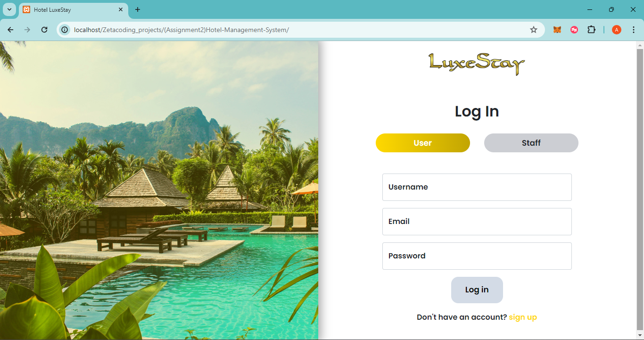
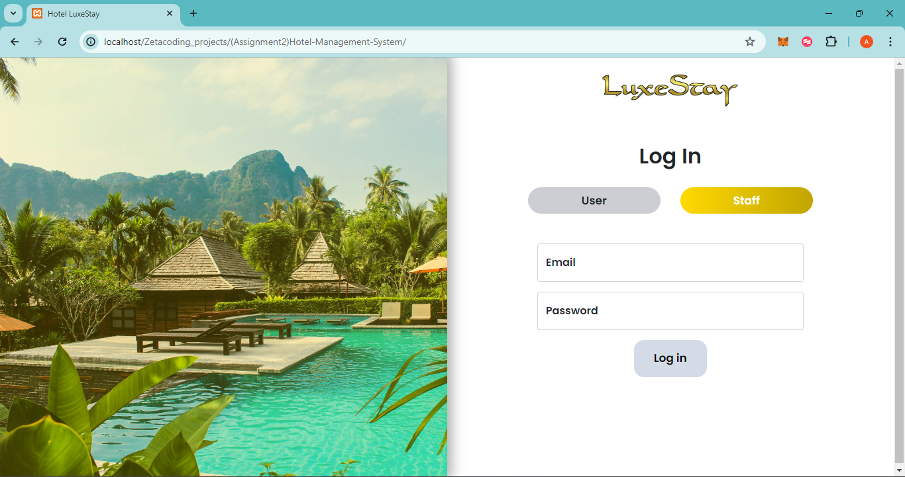
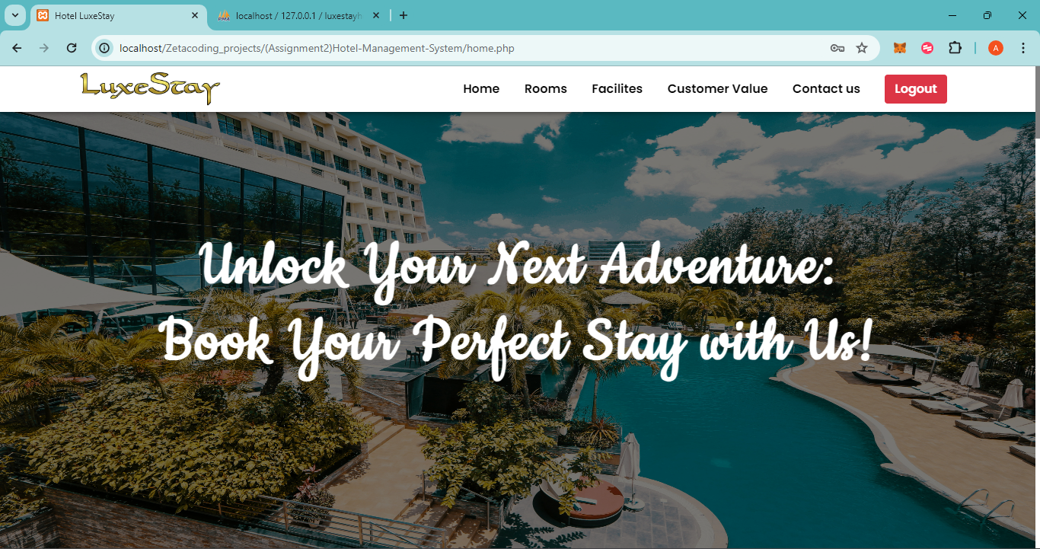
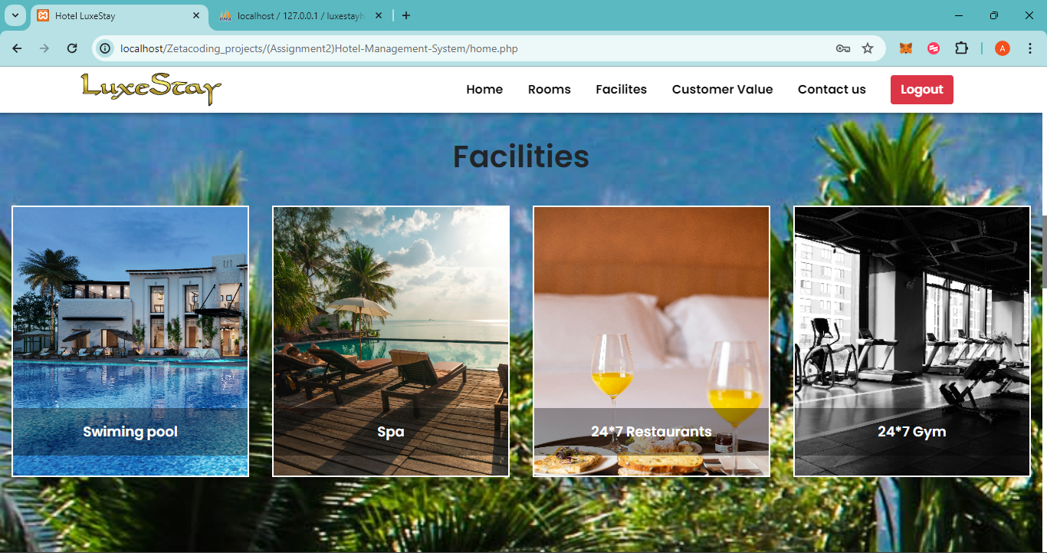
Result

Slide 13
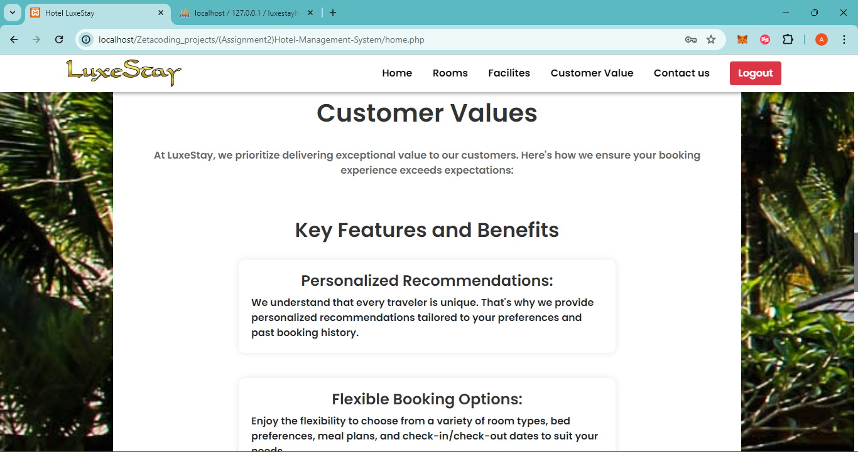
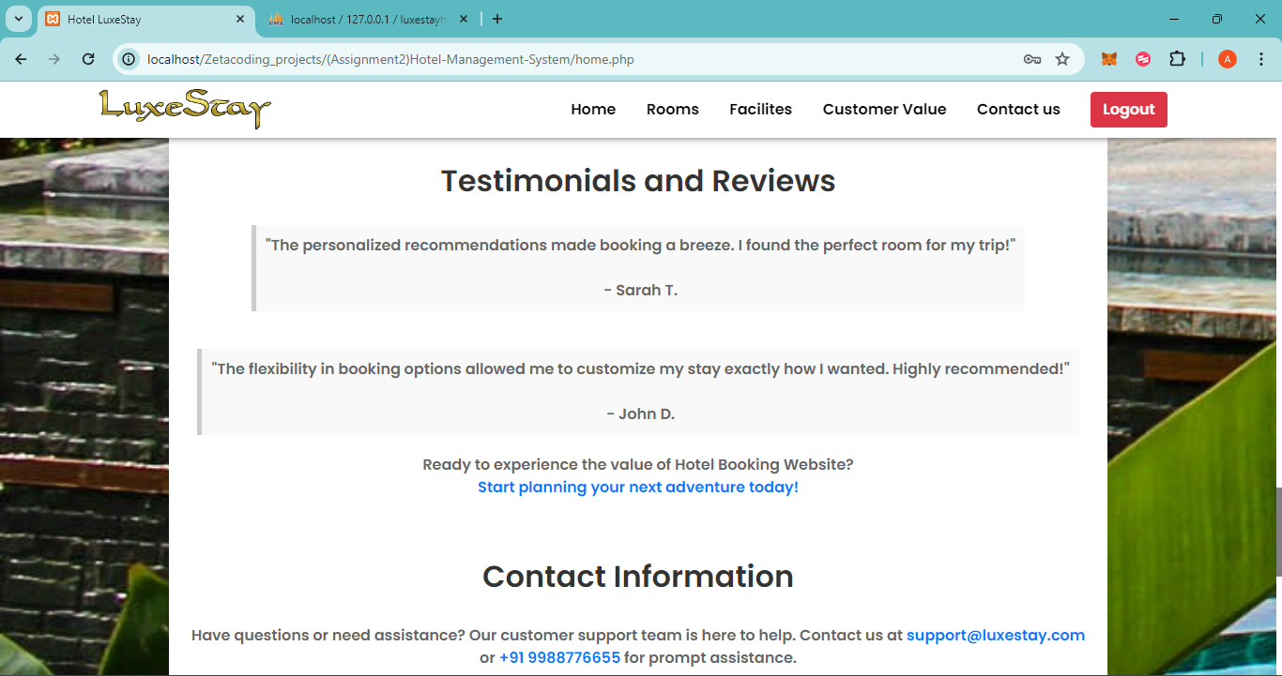
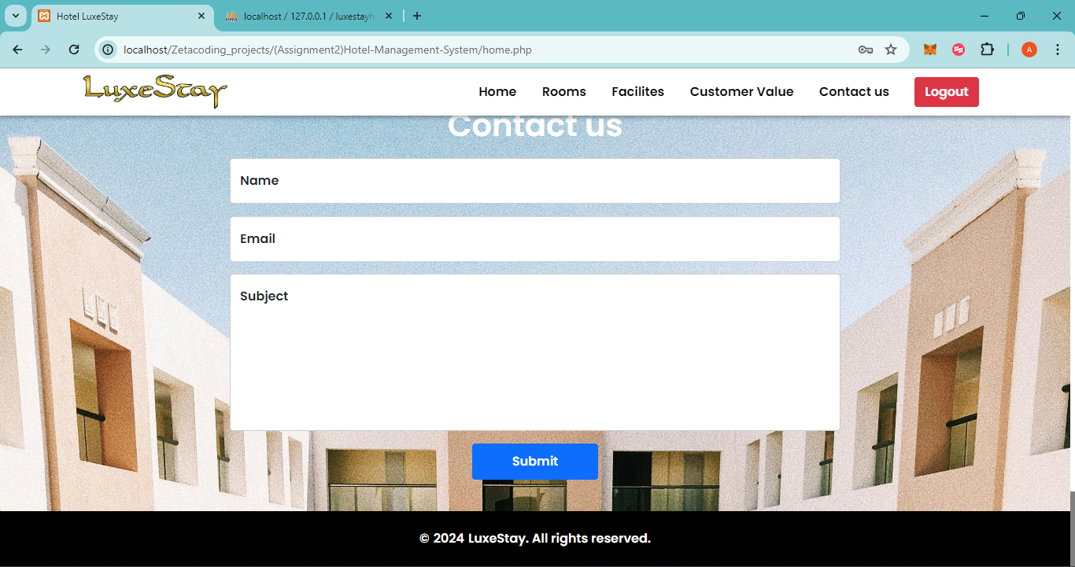
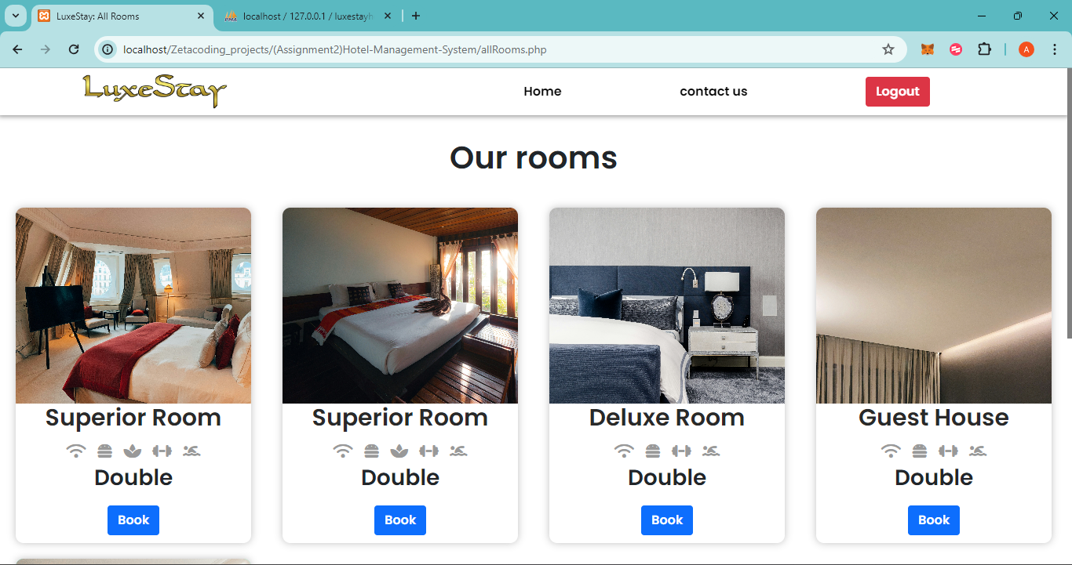
Result

Slide 14
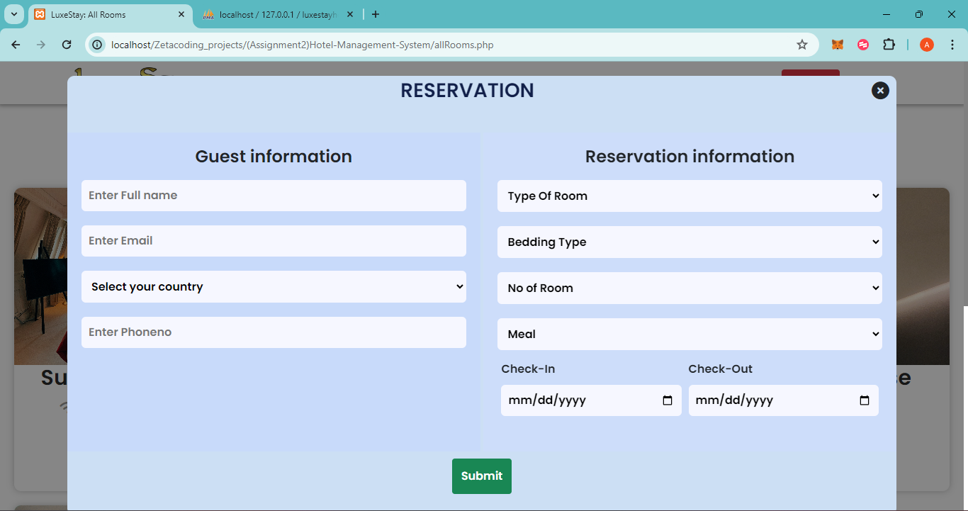
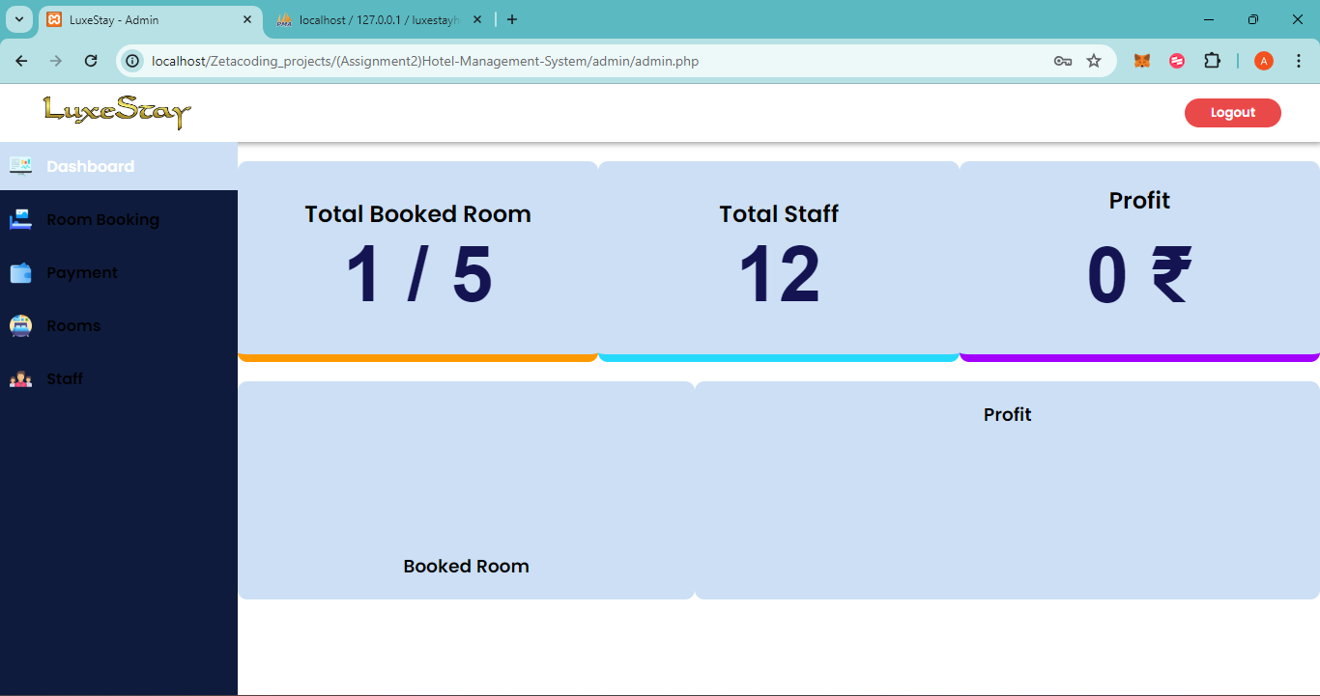
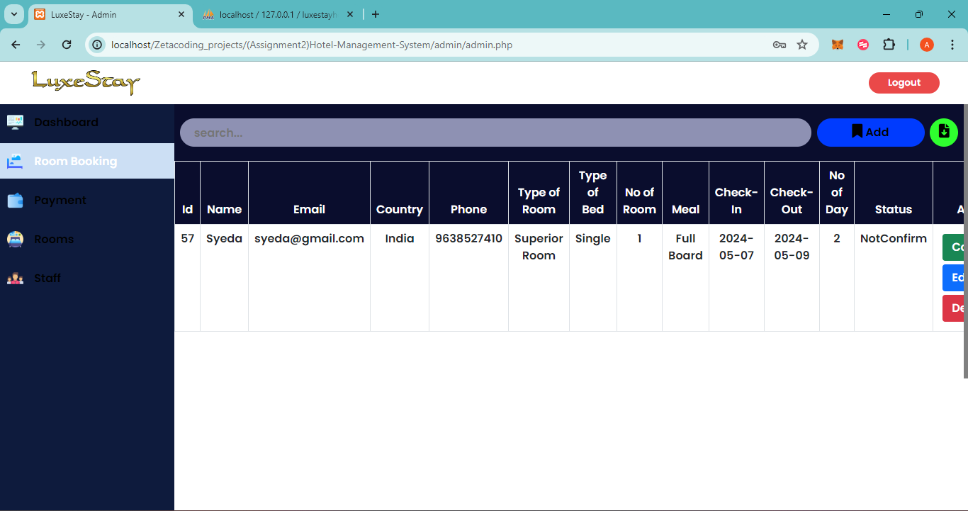
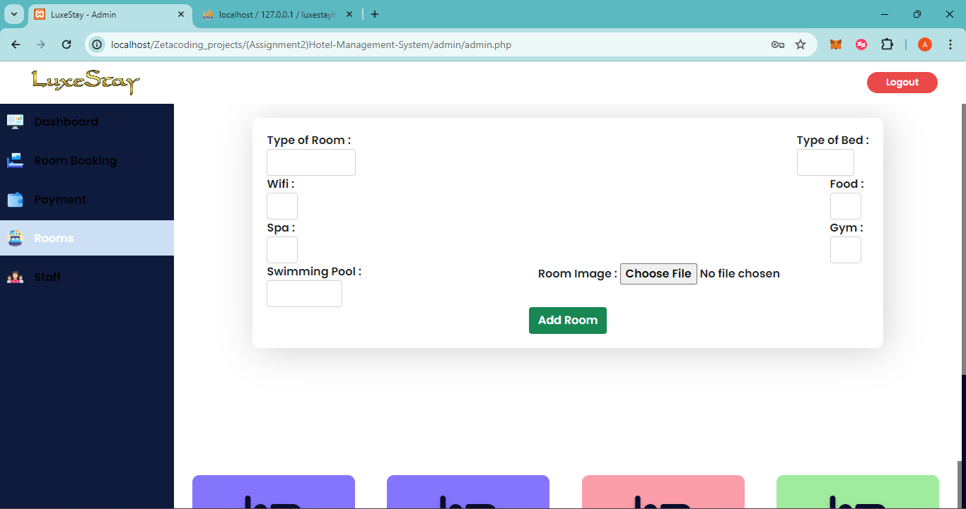
Result

Slide 15
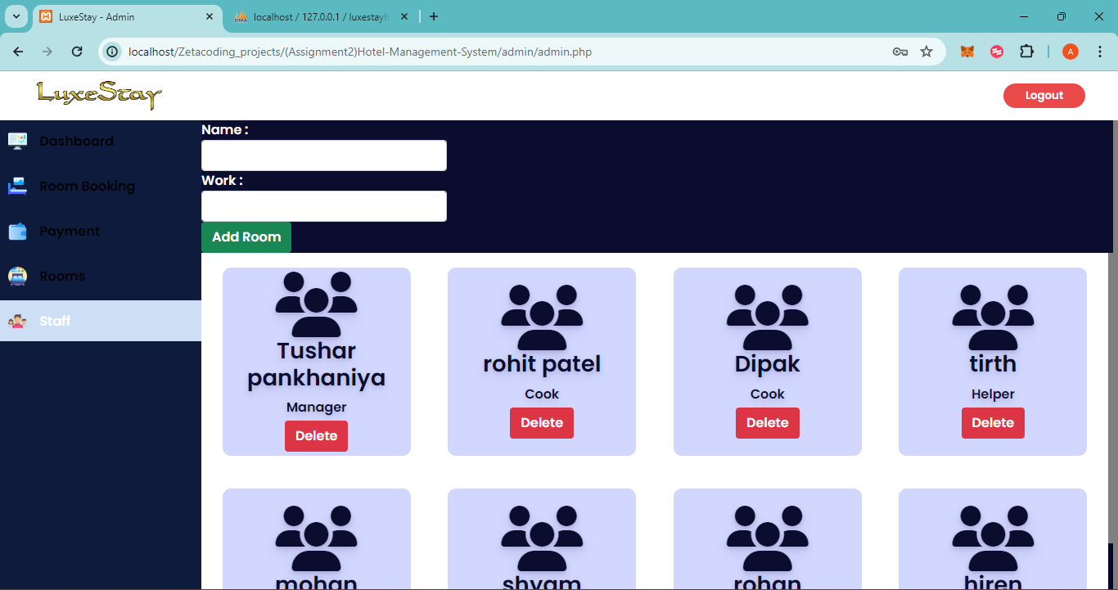
Result

Slide 16
CONCLUSION
The system which we have developed is to solve one of the major problems which is faced by many people. With the help of our system we try to solve that problem. And day by day all the sectors are being revolutionized including the hotel or lodging sector we are trying to contribute on to that revolution.
We came up with a web solution that help both the hotel staff and also the normal users making it easy for them to book the hotel and view all the options they have where as it is helpful for hotel staff as it is more convenient to handle.

Slide 17
THANK YOU

